Slide 1
OWASP SAMM User Day 2024 San Francisco

Slide 2




OWASP SAMM User Day
About Me
Jamil Ahmed, PhD www.csd.uwo.ca CSSLP www.isc2.org Senior Application Security Engineer, Fortis Games
https://www.linkedin.com/in/jamil-ahmed-phd

Slide 3
OWASP SAMM User Day
Capability Maturity Model (CMM) for Secure Software Development Life Cycle (SSDLC)
Overview
OWASP SAMM
CMM
Scope and Objective
Security Domain and Categories
Complete CMM for SSDLC
Q/A

Slide 4
OWASP SAMM User Day
Capability Maturity Model (CMM) for Secure Software Development Life Cycle (SSDLC)
Overview
Capability Maturity Model has already been evolved to effectively apply for evaluating the maturity of software and Software Development Life Cycle.
Significance of a CMM for SDLC is obvious but a functional CMM for Secure Software Development Lifecycle practice up to its all 5 levels has not been widely known
CMM intends to assess an organization’s capability up to 5 levels (Initial, Managed, Defined, Quantitatively Managed and Optimized).

Slide 5
OWASP SAMM User Day
Capability Maturity Model (CMM) for Secure Software Development Life Cycle (SSDLC)
Origin - OWASP SMM
There are several CMM proposed for the capability of CyberSecurity. However, OWASP Software Assurance Maturity Model (SAMM) is the most relevant to SSDLC.
SAMM is like a template for SSDLC to assess the AppSec posture.
OWASP SAMM is for 3 levels but I proposed maturity model of 5 typical levels of CMM around important SSDLC security domains.

Slide 6
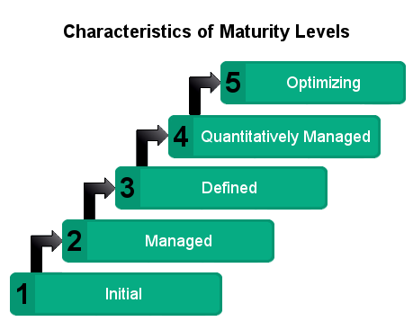
OWASP SAMM User Day
Capability Maturity Model (CMM) for Secure Software Development Life Cycle (SSDLC)
CMM

Slide 7
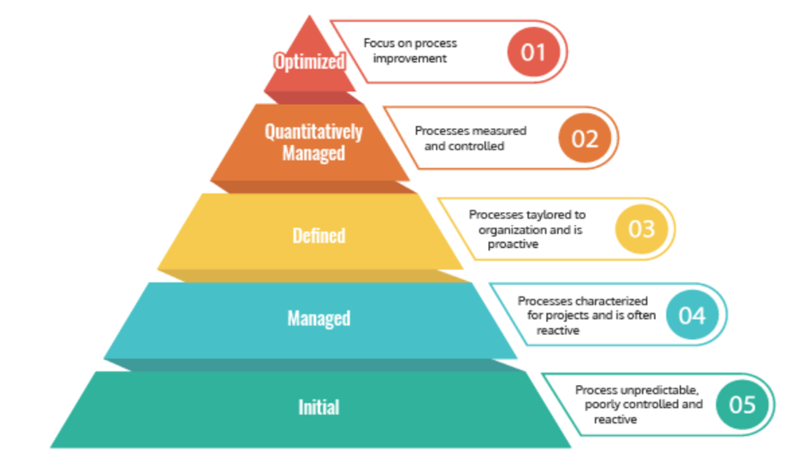
OWASP SAMM User Day
Capability Maturity Model (CMM) for Secure Software Development Life Cycle (SSDLC)
CMM

Slide 8
OWASP SAMM User Day
Capability Maturity Model (CMM) for Secure Software Development Life Cycle (SSDLC)
Scope
In a typical setting, the Application Security Team of an organization should design the CMM and roll out to the Software Engineering Teams. Both teams should coordinate to effectively optimize and tweak the maturity model according to their environment, resources and goals.

Slide 9
OWASP SAMM User Day
Capability Maturity Model (CMM) for Secure Software Development Life Cycle (SSDLC)
Objective
Shifting left is the most important goals to enhance the security posture of software development processes for an organization. Therefore, it is imperative that the CMM for SSDLC advocate the shift-left for each of the 5 levels. Higher maturity level requires more shift-left and more automation of security checks during SDLC.

Slide 10
OWASP SAMM User Day
Capability Maturity Model (CMM) for Secure Software Development Life Cycle (SSDLC)
Security Domain and Categories
The maturity model breaks down the SSDLC practice into 9 major security domains.
These 9 Security domains are mentioned in the following table. The complete model provides the description, criteria and guidelines (how to achieve the criteria) for each of the 5 levels.

Slide 11
OWASP SAMM User Day
Capability Maturity Model (CMM) for Secure Software Development Life Cycle (SSDLC)
Security Domain and Categories
Domain Category | Security Domains | Description
Governance | Security Policy and standards | Define security standards/policies and make them accessible to the engineering teams.
 | Security Role and Culture | Define security roles and make them accessible to the engineering teams. Establish the security culture.
 | Security Training | Provide Security training and makes it accessible to the engineering teams.
Design | Asset Inventory | Identify the applications’ assets and how to maintain their inventory. For example, GitHub repositories are used for maintaining the application asset “Source Code Repo”.

Slide 12
OWASP SAMM User Day
Capability Maturity Model (CMM) for Secure Software Development Life Cycle (SSDLC)
Security Domain and Categories
Domain Category | Security Domains | Description
Design | Asset Inventory | Identify the applications’ assets and how to maintain their inventory. For example, GitHub repositories are used for maintaining the application asset “Source Code Repo”.
 | Application Architecture Assessment | Security review of applications architecture in an ad hoc manner and then threat modeling for higher levels.
Implementation | Building Source Code | This include SAST and SCA scanning
 | Secure Deployment | Defines securely deploying the applications in production such as “no secrets are deployed on production server”.

Slide 13
OWASP SAMM User Day
Capability Maturity Model (CMM) for Secure Software Development Life Cycle (SSDLC)
Security Domain and Categories
Domain Category | Security Domains | Description
Verification | Dynamic Application Scanning | Runtime application scanning i.e. DAST
 | Security Testing | Black box testing of security functionality and pen testing

Slide 14
OWASP SAMM User Day
Capability Maturity Model (CMM) for Secure Software Development Life Cycle (SSDLC)
Complete CMM for SSDLC
https://github.com/Jamilirkhan/SSDLC-CMM

Slide 15

Thank you!
Please ask any questions

